Slide 1
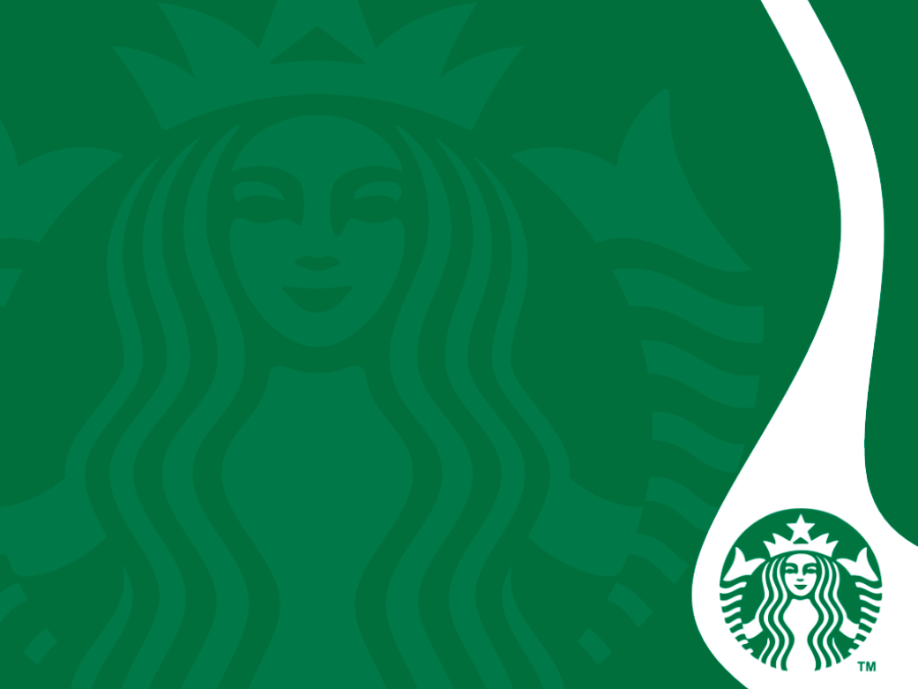
Starbucks
Napassorn Kleangklang, Alberto Pajarilla,

Slide 2
Introduction
Name: Starbucks Corporation (NASDAQ: SBUX)
Starbucks Corporation is an American Company coffee company and coffeehouse chain
Starbucks makes 91% of its revenue from sales in stores
The remaining 9% come from an assortment of other revenue
Headquarters: Seattle, Washington founded in 1971
The company has three regional divisions for the global market:
(1) Americas
(2) China and Asia-Pacific
(3) Europe, Middle East, and Africa
Notes:
Starbucks makes most of its money, 91%, by selling coffee and other products at its many
locations.
The remaining 9% of Starbucks’ revenue comes from an assortment smaller streams including ready-to-drink beverages sold outside of Starbucks’ stores and the sale of packaged coffee to various foodservice businesses
Americas: Canada, North America, and South America. Most productive division of the company.
CAP: China Asia Pacific
EMEA: Europe, Middle East, and Africa

Slide 3
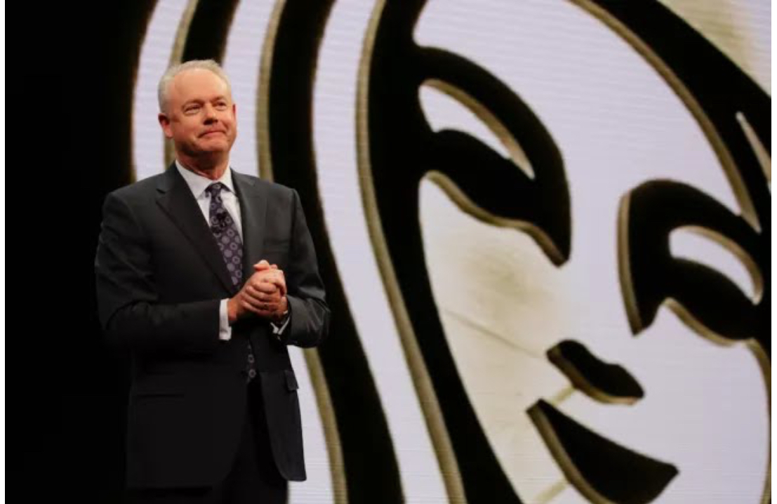
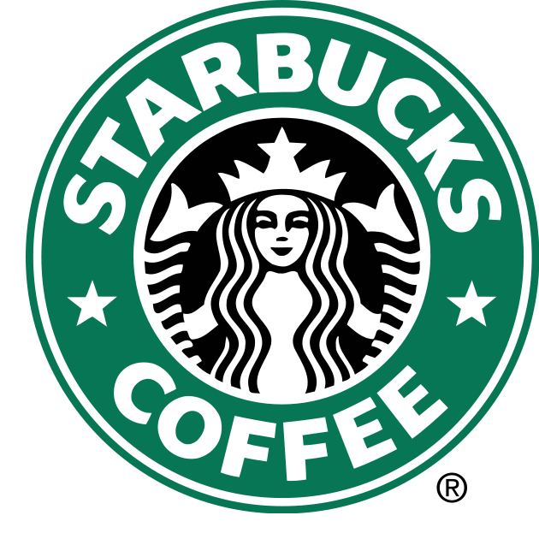
Current CEO of Starbucks
Joined Starbucks in 2009
Served on the board of directors during a time of "record-setting" renovation and development at the company
In March 2015, where he became president and chief operating officer
In April 2017 he was promoted to president and CEO, where he took over for Schultz.
Kevin Johnson
Notes:
About Kevin Johnson after Howard Schultz announces potential 2020 Presidential run

Slide 4
External Analysis

Slide 5
Overview of the Industry
Competitors: McDonald, Panera Bread, Dunkin Donut
Industry size: the United States coffee shop industry reached $47.5 billion in 2019, showing a growth of 3.3 percent from the previous year.
Industry driving forces: competitive rivalry, bargaining power of customers, and threat of substitutes
Industry critical success factors: products, customers, employees, and marketing
Notes:
The United States is well-known for producing big coffee shop brands such as Starbucks, Dunkin' Donuts, Caribou and more. Therefore it may come as no surprise that the market size of the United States coffee shop industry reached 47.5 billion U.S. dollars in 2019, showing a growth of 3.3 percent from the previous year.
Starbucks faces the strong force of competitive rivalry or competition in the food service and coffeehouse industries.
Starbucks Coffee Company experiences the strong force or bargaining power of buyers or customers. This force is based on the influence of individual customers and groups of customers on the international business environment. Based on the low switching costs, customers can easily shift from Starbucks to other brands.
Starbucks Corporation experiences the strong force or threat of substitution. This force pertains to the impact of substitute goods or services on the business and its external environment. The high availability of substitutes makes it easy for consumers to buy these substitutes instead of Starbucks products.
Product
Perhaps the biggest factor for success in the coffee business is being able to make a reasonable claim that your coffee is better than the competition. You might have a special proprietary blend, or the best on-site roasters, or baristas who can make even professed coffee-haters fall in love with their lattes. Hopefully you have all three. But giving your customers a great cup of their favorite beverage is essential to success.
Customers
You don't need to be located on the busiest street corner in town -- the traffic might not be enough to make the high rents worth it. But you do need to figure out who your customers are likely to be and make sure there are enough of them located near your business to make the numbers work. If your coffee business is a shop on the corner, make sure that there are enough people in the area who drink coffee to keep your business profitable. If you’re operating a coffee service that serves local offices, it helps to be near enough to get your products there on a timely basis.
Employees
Like in any other business, your frontline employees are your business’s prime connection to the customer. They not only make the coffee, they have a huge role in determining the culture of your business. It does little good to spend a fortune on the best coffee if the person making the cup doesn't grind the beans correctly, makes a poor-quality latte, works too slowly or is surly to the customers. A friendly, skilled barista at a coffee shop, or pleasant salesperson marketing at the local office complex, can be a huge asset to your business.
Marketing
You can serve the best coffee in the world, but it won’t do your business any good if nobody knows you’re there. Loyalty cards and social media marketing can draw in individual customers, while a sales pitch demonstrating the positive impacts on employee morale for the comparatively low cost of providing quality coffee service can be a hit with large offices. Advertising lets everyone know about your coffee and gets them in the door. Once there, it's up to the coffee itself to do the rest.

Slide 6
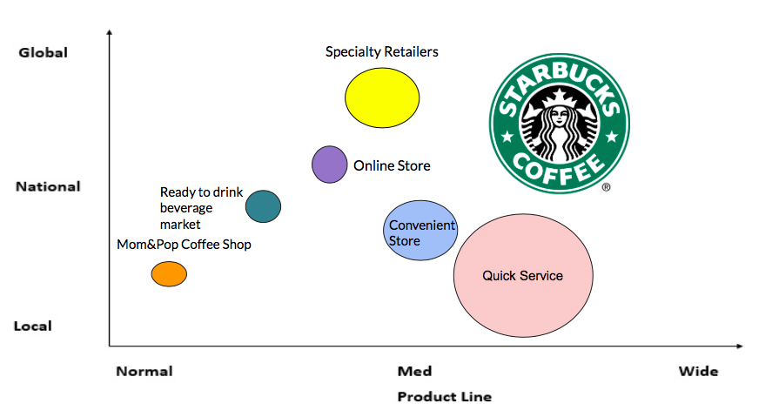
Industry Map of Ready to Drink Coffee Retails

Slide 7
Porter’s 5 Forces - Threat of Entry
Overall: (Moderate Force) | Issue | Impact on the company | Implication for strategy
Moderate | Cost of doing business | Variability of the actual cost of establishing and maintaining operations in the coffeehouse industry | Cost of operating a small coffeehouse is lower compared to the cost of operating a coffeehouse chain
Moderate | Supply chain cost | Smaller cafes have lower supply needs | external factors enable smaller firms to do business against starbucks
Weak | Cost of brand development | Brand development is costly | Reduces the threat of substitution
Moderate | New entrants can compete with brands like Starbucks at local level | the barriers are not very high and the initial investment to start a coffee brand is not high | the new brands can attract customers using lower prices
Notes:
Starbucks Corporation faces the moderate force or threat of new entry.This force refers to the effect of new players or new entrants in the industry. In this business case, the following external factors contribute to the moderate threat of new entrants against Starbucks:
The combination of these external factors imposes the moderate force or threat of substitutes against the company. Thus, this Five Forces analysis shows that the threat of substitution is a significant but limited issue in Starbucks Corporation’s strategic management.

Slide 8
Porter’s 5 Forces - Threat of Substitute
Overall: (Strong Force) | Issue | Impact on the company | Implication for strategy
Strong | High substitute availability | Substitute have strong potential to negative impact Starbucks business | High availability substitutes makes it easy for consumers to buy substitutes instead of Starbucks products
Strong | Low switching costs | low switching costs further strengthen the threat for substitutes | It is easy for consumers to buy substitutes instead of Starbucks products
Strong | High affordability of substitute products | Substitute are affordable and cost less than the company’s products | Threat of substitutes is a high-priority strategic management concern
Strong | There are several substitutes available in the market | there are pubs and restaurants that provide both good ambience and quality products
Notes:
Starbucks Corporation experiences the strong force or threat of substitution. In the Five Forces analysis model, this force pertains to the impact of substitute goods or services on the business and its external environment. The following external factors contribute to the strong threat of substitution against Starbucks:
Thus, this Porter’s Five Forces analysis of Starbucks Coffee Company determines that the threat of substitutes is a high-priority strategic management concern.

Slide 9
Porter’s 5 Forces - Power of Buyers
Overall: (Strong Force) | Issue | Impact on the company | Implication for strategy
Strong | Low switching costs | Low switching costs, customers can easily shift to other brands | Bargaining power of buyers is among the most significant forces affecting the company
Strong | High substitute availability | High substitute availability customers can stay away from Starbucks | There are many substitutes like instant beverages from vending machine
Weak | Small size of individual buyers | Weak influence of individual buyers on the business | The bargaining power of customers is a top-priority strategic issue
Moderate | Size of individual purchases is small | Single buyers do not hold enough influence | Prices cannot be excessively high because customers watch for such trends and would start switching
Notes:
Starbucks Coffee Company experiences the strong force or bargaining power of buyers or customers. In Porter’s Five Forces analysis model, this force is based on the influence of individual customers and groups of customers on the international business environment. In Starbucks Corporation’s case, the following external factors contribute to the strong bargaining power of customers:
Thus, this component of the Five Forces analysis shows that the bargaining power of customers is a top-priority strategic issue. Starbucks Corporation’s marketing mix or 4Ps provide support for brand strengthening to partially address the bargaining power of consumers.

Slide 10
Porter’s 5 Forces - Power of Suppliers (Weak Force)
Overall: | Issue | Impact on the company | Implication for strategy
Moderate | Moderate size of individual suppliers | The moderate size of individual suppliers is an external factor that imposes a moderate force on Starbucks | Supplier’s bargaining power is a minor strategic issue in managing the business
Weak | High variety of suppliers | The high variety of suppliers weakens their bargaining power | Suppliers have various strategies and competencies that they use to compete against each other
Weak | Large overall supply | The bargaining power of suppliers is further weakened because of the large overall supply | There are many suppliers of coffee around the world. This external factor limits the influence of individual suppliers
Notes:
Starbucks Coffee faces the weak force or bargaining power of suppliers. Porter’s Five Forces analysis model considers this force as the influence that suppliers have on the company and its industry environment. The following external factors contribute to the weak bargaining power of suppliers on Starbucks Corporation:
he overall effect of the external factors in this component of the Five Forces analysis is the weak force or bargaining power of suppliers on the company.
As a result, suppliers’ bargaining power is a minor strategic issue in managing the business.

Slide 11
Porter’s 5 Forces - Intensity of Rivalry (Strong Force)
Overall: | Issue | Impact on the company | Implication for strategy
Strong | Large number of firms | Large number of firms is an external factor that intensifies competitive rivalry | Starbucks Corporation has many competitors of different sizes
Moderate | Moderate variety of firms | Population of competitors is moderate varied in terms of specialty and strategy | Moderate variety further strengthens the level of competition in the industry
Strong | Low switching costs | Competition is strengthened because of the low switching costs, which are the disadvantages to consumers when shifting from one provider to another | Competition is among the company’s top-priority challenges
Notes:
Starbucks faces the strong force of competitive rivalry or competition in the food service and coffeehouse industries. In the Five Forces analysis model, this force pertains to the influence of competitors on each other and the industry environment. In this case of Starbucks Coffee Company, the following external factors contribute to the strong force of competition:
Competition is among the company’s top-priority challenges. Starbucks Corporation’s generic strategy and intensive growth strategies are a reflection of strategic responses to competition.

Slide 12
PEST Analysis: Political
Issue | Impact | Implication
Regional integration of market | Current trend and external factors opportunity global expansion | Mostly present opportunities for Starbucks coffee
Government infrastructure | Difficulty for constructions | Explore additional options for construction sites
Positive economic reform bring more foreign companies | Profit increase | Expand the business into every city

Slide 13
PEST Analysis: Economy
Issue | Impact | Implication
High growth in developing countries | Gain revenue | Increase revenue from various countries
Increase inflation | Consumers will decrease | Make categories of quality
Rising labor cost | Increase company’s spending | Cost of coffee beans from developing countries are higher

Slide 14
PEST Analysis: Social
Issue | Impact | Implication
Growing coffee culture | Increase revenue based on increasing demand | Presents on opportunity to expand
More consumption in urban areas | Low sales in rural areas | Increase in geographical area
Increase in middle class sector | Increase revenue based on increasing demand | Presents on opportunity to expand

Slide 15
PEST Analysis: Technological
Issue | Impact | Implication
Inefficient machinery | Production is not up to the mark | Upgrade to the latest machinery
Poor record keeping | Increased maintaining costs | Purchased good quality machine
Expensive equipments | Low production | Hire a manager with software expertise

Slide 16
Market Analysis
Target’s market: General population, men and women who are aged 25 to 40. They account for almost half (49 percent) of its total business (like the coffee chain consumers)
The target audiences for Starbucks share a variety of characteristics, including a high-income, an awareness of social status and environmental consciousness.
Size and growth of the target market: Growing due to increasing of stores, customer loyalty program, memberships card.
Distribution channel : Direct retail company-own stores, Retail stores, CPG merchandise, Supermarket, shopping centre, office coffee suppliers such as hotel, airlines, and mobile distribution channel.
Price sensitivity of customers : medium to high
Market trends: Revenue in the Coffee segment amounts to $429,478m in 2019. The market is expected to grow annually by 5.8%.
Notes:
http://thecoffeeteam.blogspot.com/2012/02/starbucks-distribution-channel.html

Slide 17
Benchmark Analysis - Finance
Finance | Starbucks | McDonald | Panera Bread | Dunkin Donut | Industry
Net profit margin | 18.28% | 28.18% | 5.18% | 17.39% | 17.25%
Return on assets | 18.70% | 18.06% | (11.93) | 6.68% | 7.87%
Debt to equity | 8.07 | (4.97) | 1.7 | (4.22) | .14%
Debt to assets | .39 | .95 | .36 | .29 | .49
Current ratio | 2.20 | 1.36 | .79 | 1.51 | 1.46
Based on: 10-K (filing date: 2018-11-16)

Slide 18
Benchmark Analysis - Employees
Efficiency | Starbucks | McDonald | Panera Bread | Dunkin Donut | Industry
Average number of employees | 1 | 2 | 4 | 3 | 2.5
Annual revenue per employee | 2 | 3 | 5 | 1 | 2.5
Annual compensation per employee | 1 | 2 | 4 | 4 | 2.5
Flexibility of organizational structure | 2 | 3 | 1 | 2 | 2.5
Ability to attract & retain the best people | 1 | 3 | 1 | 3 | 2.5
Notes:
Average number of employees
First, Starbucks 291,000.
Second, McD 210,000
Third, Dunkin Donut 180,000 third,
And fourth Penera is the last 100,000
Annual revenue per employee
Dunkin Donut 370,666
Starbucks 111,381
McD 49,594
Panera 8,724

Slide 19
Benchmark Analysis - Sales
Sales | Starbucks | McDonald | Panera Bread | Dunkin Donut | Median
Sales growth percentage | 2 | 2.5 | 3 | 3 | 2.6
Market share | 1 | 2 | 3 | 3.5 | 2.4
Customer Loyalty | 2 | 2 | 3 | 4 | 2.5
Advertising | 2.5 | 2 | 2.5 | 3 | 2.5
1 = Superior; 5 = Poor
Notes:
Scale

Slide 20
Benchmark Analysis - Growth
Growth | Starbucks | McDonald | Panera Bread | Dunkin Donut | Industry
Total Sales (2018 and 2017 comparison | 24.72 B | 21.3 B | 7.5 B | 1.32 B | 13.71 B
Revenue (past 12 months) | 24.71 B | 5.43 B | 2.795 B | 1.32 B | 8.56 B
Net income growth (past 12 months) | 4.52 B | 5.2B | 145 M | 229.91 M | 2.52 B
Notes:
Keep it for now

Slide 21
Benchmark Analysis - Products
Products | Starbucks | McDonald | Panera Bread | Dunkin Donut | Average
Product quality | 1 | 4 | 3 | 2 | 2.5
Product price point | 4 | 2 | 4 | 1 | 2.75
New product development rate | 1 | 4 | 3 | 2 | 2.5
Product replacement cycle | 1 | 2 | 3 | 2 | 2
1 = Superior; 5 = Poor
Notes:
Scale

Slide 22
CEO Book Questions (External)
Is there excess capacity in the industry?
Yes, there is still a big room for the newcomers. This can be seen from the fact that the new businessmen make up their place in the market if they come up with new innovative ideas.
Is the industry consolidating?
Yes the coffee industry is consolidating. There’s a lot of money being spent and the coffee segment is continuing to grow, but a lot of this growth is not coming from the brands that defined the category in the 20th century.
Might your business be affected by currency fluctuations or changes in interest rates (up or down)?
In simple terms, when there's an excessive supply of something the value attached to it decreases, while an increase in demand raises value. The factors detailed below can impact supply and demand of currency, and cause the exchange rate to fluctuate. However, more deliberate factors may also be at play. So there are regular fluctuations somehow in Starbucks business too.

Slide 23
CEO Book Questions (External)
4. Are you facing new competitors?
Yes, like all other big business Starbucks also face big competitors globally. Some big competitors include Mcdonald’s , Dunkin Donuts, and Panera Bread
5. Where is innovation coming from?
Starbucks (SBUX) is easily the biggest name in coffee. The Starbucks corporation has grown to sell its products in almost 30,000 locations worldwide and has one of the most recognizable brands on Earth. Schultz left Starbucks to in 2018. In 2018 the company operated in 78 markets and was worth over $24 billion.
6. What is happening in e-commerce? How might that affect the company?
In 2018 the company operated in 78 markets and was worth over $24 billions. "Starbucks makes the 91% of its revenue from sales in stores. Starbucks’ greatest strength is its brand. In 2019, Starbucks’ revenue growth fell to 3% from 10.42% in 2018."

Slide 24
EFE-Analysis
Opportunities | Weight | Rating | Score
1.Expansion in developing countries | 0.025 | 4 | 0.100
2.Business diversification | 0.025 | 3 | 0.075
3. Partnership with other firms | 0.030 | 2 | 0.060
4. Product innovation and new growth platforms | 0.030 | 2 | 0.060
5. Leverage Starbucks brand outside the store base | 0.030 | 1 | 0.030
6. Expand in Chinese market | 0.035 | 3 | 0.105
7. High growth potential of the single-serve coffee market | 0.040 | 4 | 0.160
8. High growth potential for courtesy coffee product | 0.045 | 2 | 0.090
9. Increase in the number of diners out-customers | 0.050 | 2 | 0.100
10. Flexible prices and offer smaller portion size | 0.025 | 3 | 0.075
Rating Scale:
4 = Superior
3 = Above Average
2 = Average
1 = Poor
Notes:
Starbucks Corporation can increase its revenues through expansion in developing markets. This opportunity draws attention away from the U.S. market, where most of the company’s revenues are generated.
Also significant in this SWOT analysis is business diversification, which can improve Starbucks’s long-term stability.

Slide 25
Threats | Weight | Rating | Score
Competitions involving low-cost coffee sellers | 0.060 | 4 | 0.240
2. Imitations | 0.065 | 3 | 0.195
3. Independent coffee house movement | 0.070 | 3 | 0.210
4. Supply and price of coffee is subject to significant volatility | 0.050 | 2 | 0.100
5. Multiple competitors | 0.060 | 2 | 0.120
6. Economic uncertainty | 0.080 | 4 | 0.320
7. Increase competition from local new entrants market | 0.025 | 4 | 0.100
8. Trademark infringement | 0.090 | 2 | 0.180
9. Price sensitivity of customers | 0.085 | 3 | 0.255
10. Rising market | 0.080 | 1 | 0.080
Total Weight: 1.000 | Total Score: 2.655
Notes:
Starbucks Corporation competes against a wide variety of firms in the international market. For example, the company competes against major restaurant chains that offer low-cost coffee products. This external strategic factor threatens Starbucks because such competitors can reduce the company’s market share by competing based on low prices.
Also, this SWOT analysis considers imitation as a major threat against the coffeehouse business. In light of the company’s weaknesses, the threat of imitation involves firms that try to copy the taste, look and feel of Starbucks products.

Slide 26
Internal Analysis
Notes:
Starbucks Corporation purchases and roasts high-quality whole bean coffees and sells them along with fresh, rich-brewed, Italian style espresso beverages, a variety of pastries and confections, and coffee-related equipments primarily through its company-operated retail stores. In addition to sales through its company-operated retail stores, Starbucks sells whole bean coffees through a specialty sales group and supermarkets. Additionally, Starbucks produces and sells bottled Frappuccino coffee drink and a line of premium ice creams through its joint venture partnerships and offers a line of innovative premium teas produced by its wholly owned subsidiary, Tazo Tea Company. The company's objective is to establish Starbucks as the most recognized and respected brand in the world.

Slide 27
Five Year Financial Analysis-Liquidity
Ratio | 2014 | 2015 | +/- | 2016 | +/- | 2017 | +/- | 2018 | +/-
Current Ratios | 1.37 | 1.08 | -0.29 | 1.04 | -0.04 | 1.25 | +0.21 | 2.1 | +0.85
Quick or Acid-Test Ratio | 1.01 | 0.73 | -0.28 | 0.74 | +0.01 | 0.93 | +0.19 | 1.95 | +1.02

Slide 28
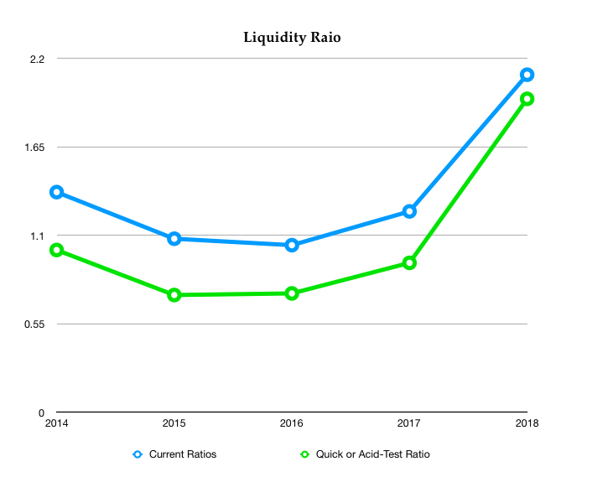

Slide 29
Five Year Financial Analysis-Leverage
Ratio | 2014 | 2015 | +/- | 2016 | +/- | 2017 | +/- | 2018 | +/-
Debt-to-Total-Asset | 0.17 | 0.19 | +0.02 | 0.22 | +0.03 | 0.27 | +0.05 | 0.38 | +0.11
Debt-to-Equity | 0.38 | 0.40 | +0.02 | 0.60 | +0.20 | 0.72 | +0.12 | 0.80 | +0.08
Long-Term Debt-to-Equity | 0.27 | 0.28 | +0.01 | 0.35 | +0.07 | 0.41 | +0.06 | 0.88 | +0.47
Notes:
LT Debt to Total Asset is a measurement representing the percentage of a corporation's assets that are financed with loans and financial obligations lasting more than one year. The ratio provides a general measure of the financial position of a company, including its ability to meet financial requirements for outstanding loans. A year-over-year decrease in this metric would suggest the company is progressively becoming less dependent on debt to grow their business.

Slide 30
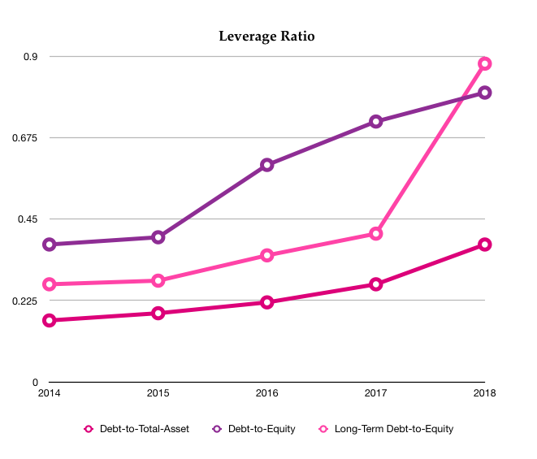
Five Year Financial Analysis-Leverage
Notes:
https://library.morningstar.com/v2/quote?id=0P00000546&typeid=ST

Slide 31
Five Year Financial Analysis-Activity
Ratio | 2014 | 2015 | % +/- | 2016 | % +/- | 2017 | % +/- | 2018 | % +/-
Inventory-Turnover Ratio | 6.28 | 5.96 | -0.32 | 6.17 | 0.21 | 5.18 | -0.99 | 5.66 | 0.48
Total-Asset Turnover | 1.48 | 1.65 | 0.16 | 1.59 | -0.06 | 1.56 | -0.03 | 1.28 | -0.28
Fixed-Asset Turnover | 4.90 | 5.04 | 0.14 | 4.94 | -0.1 | 4.74 | -0.20 | 4.56 | -0.18

Slide 32
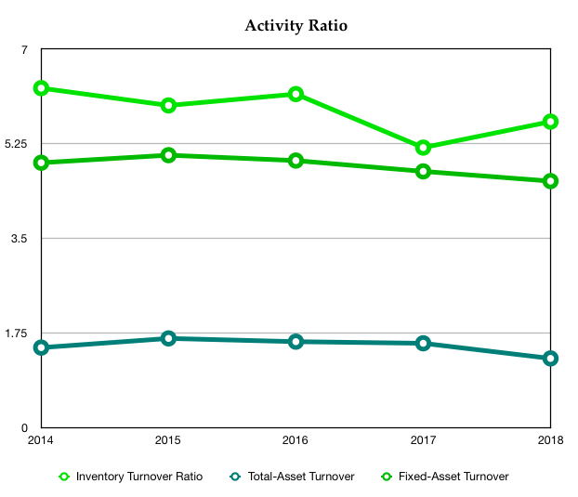
Five Year Financial Analysis-Activity

Slide 33
Five Year Financial Analysis-Profitability
Ratio | 2014 | 2015 | % +/- | 2016 | % +/- | 2017 | % +/- | 2018 | % +/-
Gross Margin | 58.29 | 59.36 | +1.07 | 60.08 | +0.72 | 68.43 | +8.35 | 67.91 | -0.52
Operating Margin | 16.98 | 17.49 | +0.51 | 18.08 | +0.59 | 17.41 | -0.67 | 15.40 | -2.01
Net Profit Margin | 12.57 | 14.39 | +1.82 | 13.22 | -1.17 | 12.89 | -0.33 | 18.28 | +5.39
Return on Total Asset (ROA) | 19.22 | 22.22 | +3.00 | 19.69 | -2.53 | 20.08 | +0.39 | 18.70 | -1.38
Return on Equity | 41.01 | 46.26 | +5.25 | 49.67 | +3.41 | 50.81 | +1.14 | 115.48 | +64.67
Return on Stockholders’ Equity | $5.27B | $5.82B | $0.55B | $5.89B | $70 M | $5.46B | $0.43B | $1.18B | $4.28B
Earning per Share | 1.35 | 1.82 | - | 1.90 | +0.08 | 1.97 | +0.07 | 3.24 | +1.26
EBITDA Margin % | 24.15 | 25.61 | +1.46 | 24.91 | -0.7 | 24.47 | -0.44 | 29.35 | +4.88
Notes:
Starbucks annual and quarterly earnings per share history from 2006 to 2019. Earnings per share can be defined as a company's net earnings or losses attributable to common shareholders per diluted share base, which includes all convertible securities and debt, options and warrants.
Starbucks EPS for the quarter ending September 30, 2019 was $0.66, a 11.86% increase year-over-year.
Starbucks EPS for the twelve months ending September 30, 2019 was $2.92, a 9.88% decline year-over-year.
Starbucks 2019 annual EPS was $2.92, a 9.88% decline from 2018.
Starbucks 2018 annual EPS was $3.24, a 64.47% increase from 2017.
Starbucks 2017 annual EPS was $1.97, a 3.68% increase from 2016.
https://simplywall.st/stocks/us/consumer-services/nasdaq-sbux/starbucks/news/starbucks-corporation-nasdaqsbux-is-employing-capital-very-effectively/

Slide 34
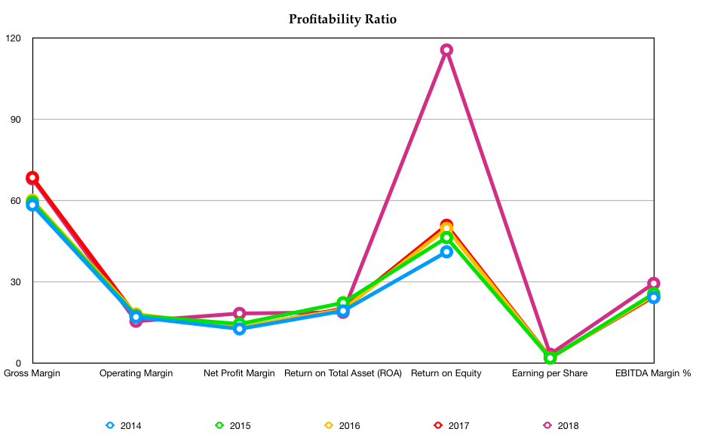
Five Year Financial Analysis-Profitability

Slide 35
Five Year Financial Analysis-Growth
Ratio | 2014 | 2015 | % +/- | 2016 | % +/- | 2017 | % +/- | 2018 | % +/-
Sales increase
Earnings per share | 1.35 | 1.82 |  | 1.90 |  | 1.97 |  | 3.24
Dividends payout ratio

Slide 36
Five Year Financial Analysis-Valuation
Ratio | 2014 | 2015 | % +/- | 2016 | % +/- | 2017 | % +/- | 2018 | % +/-
P/E Ratio | 30.28 | 32.98 |  | 29.22 |  | 29.15 |  | 19.88
Price to Book | 11.68 | 15.33 |  | 13.75 |  | 14.83 |  | 68.46
Profit Margin on sales
Return on Network
January 1st stock price
Net income
Gross income

Slide 37
CEO Book Questions - Internal
What were your company’s sales during the last year?
Are they growing, declining or flat? What do you think about this growth picture?
What you company’s gross margin? Is it growing, declining, or flat?
How does your margin compare with competitors margins? .
Do you know your company’s inventory velocity?

Slide 38
CEO Book Questions - Internal
Do you know your company’s accounts receivable?
Who are your company’s largest customers?
What is your company’s return on invested capital?
Is your company’s cash generation increasing or decreasing? Why is it going one way or the other?
Is your company gaining or losing against the competition in terms of market share, profitability, and the like?

Slide 39
Current Mission Statement
To inspire and nurture the human spirit, one person, one cup,
and one neighborhood at a time.

Slide 40
Vision Statement
To establish Starbucks as the premier purveyor of the finest
coffee in the world while maintaining our uncompromising
principles while we grow.

Slide 41
Current Strategy
Starbucks details three strategic priorities to regain revenue and earnings momentum by :
Accelerating growth in the U.S. and China, the company’s targeted long-term growth markets;
Expanding and leveraging the global reach of the brand through the Global Coffee Alliance; and
Sharpening the focus on increasing shareholder returns.
Released on June 19, 2018
Notes:
https://stories.starbucks.com/press/2018/starbucks-announces-strategic-priorities/

Slide 42
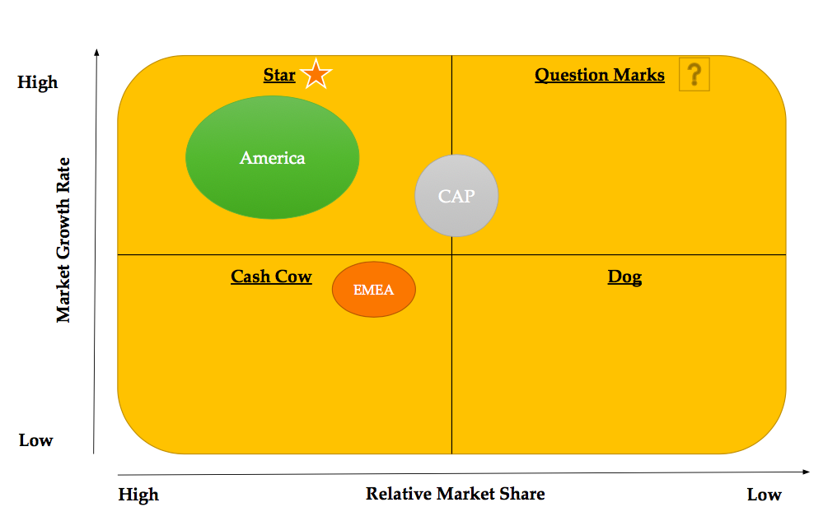
BCG Matrix
Notes:
https://www.slideshare.net/VikkasMalhotra/starbucks-casestudy-164669

Slide 43
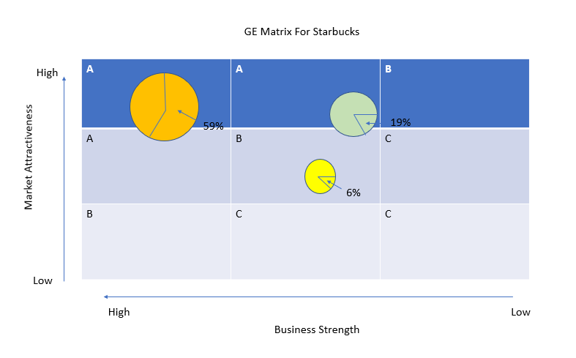
GE Matrix

Slide 44
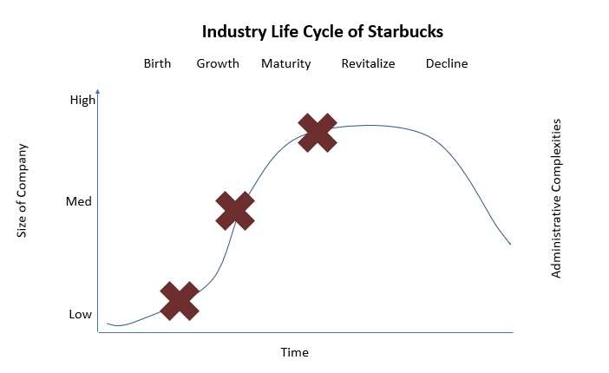
Company Life Cycle

Slide 45
Corporate Culture Analysis
Dimensions of Organizational Culture | Rate | Evidence
Attention to Detail | Good
Outcome Orientation | Satisfied
People Orientation | Excellent | With customers, employees and suppliers. Giving equitable treatment to each employee is the norm at Starbucks and it also applies to customers and suppliers.
Team Orientation | Satisfied | its culture is still rooted in modesty. Everyone must feel included from the frontline to the top management. Apart from that customers must feel valued and welcomed.
Aggressiveness | Good
Stability | Excellent
Innovation and Risk Taking | Excellent
Notes:
Starbucks Coffee’s organizational culture is a key success factor in the business, considering that the company sells not just its coffee and other food and beverage products, but also the experience of buying and consuming these products.
https://notesmatic.com/2018/10/starbucks-organizational-culture/

Slide 46
A Summary of “The Starbucks Experience”
Starbucks has become a top global brand by adhering to the following five key principles
“Make it your own” – Customize the experience.
“Everything matters” – Focus on every aspect of the job. Never ever lose your focus on your customer’s experience and point of view.
“Surprise and delight” – Do the unexpected to make buying a cup of coffee enjoyable.
“Embrace resistance” – Learn from your mistakes.
“Leave your mark” – Do your job so that your customers remember you.

Slide 47
IFE Matrix
Strengths | Weight | Rating | Score
1.Internationally known, strong valuable brands | 0.100 | 4 | 0.4
2.Efficiency and effectiveness in supply chain | 0.025 | 3 | 0.075
3.High quality of products and service | 0.100 | 4 | 0.4
4.Starbucks experience | 0.075 | 4 | 0.3
5.High accessibility (Starbucks at every corner) | 0.075 | 3 | 0.225
6.Strong relationship with suppliers (low risk of non-delivery) | 0.025 | 3 | 0.075
7.Starbucks Global Responsibility strategy | 0.100 | 3 | 0.3
8.Strong market positions | 0.100 | 4 | 0.4
9.Digital Mobile Outlet | 0.025 | 3 | 0.075
10.High market expansion in China, India, Russia | 0.100 | 4 | 0.4

Slide 48
IFE Matrix
Weaknesses | Weight | Rating | Score
1.Dependent on relationship with suppliers | 0.050 | 1 | 0.05
2.Health effects of consuming Starbucks products | 0.100 | 1 | 0.1
3.Natural disasters may largely affect supply | 0.075 | 1 | 0.075
4.Dependent on US operating segment (75% of total revenues in 2010) | 0.100 | 2 | 0.2
5.Future growth is increasingly dependent on international operating segment | 0.100 | 2 | 0.2
6.Regional or global health pandemic could affect business | 0.075 | 2 | 0.15
7.High Prices
8. Recall products
9. Unethical environmental practises
10. Generalized standard for most products

Slide 49
Directional Indicators

Slide 50
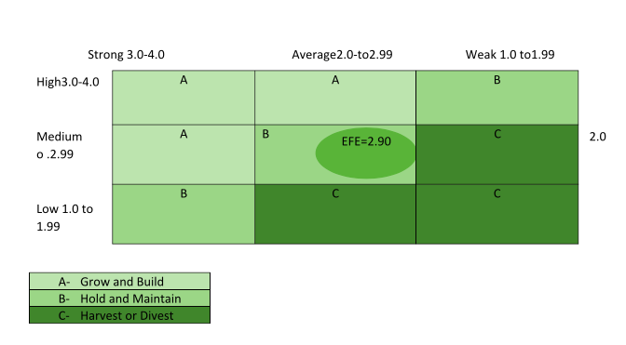
I/E Matrix

Slide 51
SPACE Matrix
 | Internal strategic position | External strategic position
Y-axis | Financial Strength (FS) (score: +6 best, +1 worst) | Environmental Stability (ES) (score: -1 best, -6 worst)
Total y-axis score: 5.4 - 2.8 = 2.8 | 5 : Return on Investment 6 : Net Income 4 : Price Earning Ratio 6 : Working Capital 6 : Cash Flow Average: 5.4 | -3 : Competitive Pressure -3 : Inflation rate -1 : Rapid technology change -2 : Price Range of Competing Service -5 : Demand Variability Average: -2.8
 | Internal strategic position | External strategic position
X-axis | Competitive Advantage (CA) (score: -1 best, -6 worst) | Industry Strength (IS) (score: +6 best, +1 worst)
Total x-axis score: -1.6 + 5.2 = 3.6 | -1 : Market share -2 : New product development -2 : Customer Loyalty -1 : Competition’s Capacity -2 : Control over Suppliers and Distributors Average: -1.6 | 5 : Growth potential 5 : Financial Stability 5 : Ease of Entry into Market 5 : Resource Utilization 6 : Profit Potential Average: 5.2
Notes:
Highlight 2 points to describe them

Slide 52
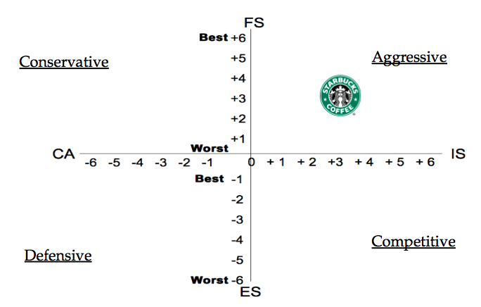
SPACE Matrix
Y=2.8
X=3.6
Notes:
We want to move forward in order to expand our compnay to Asia and Europe. Why our company is an aggressive?

Slide 53
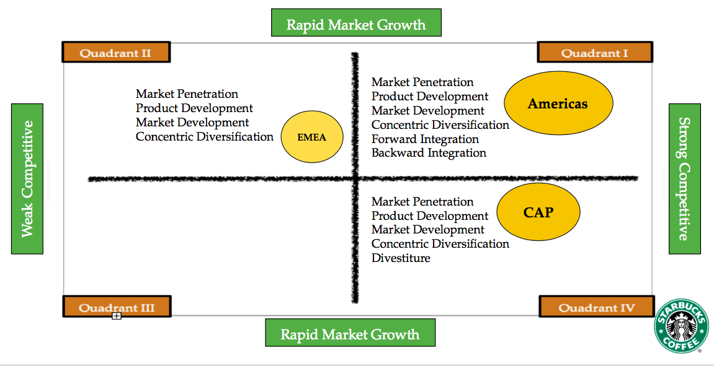
Grand Strategy Matrix
Notes:
p.155 and Highlight 2 points to describe them. EMEA= Europe Middle Eastern and Africa. CAP=China and Asia Pacific.

Slide 54
Strategic Alternatives

Slide 55
Ansoff Matrix
Market Development (Risk=Moderate) | Diversification (Risk=High)
International Expansion (CAP, EMEA) Provide new products into existing coffee houses Identify current customers needs Adjust prices to new market Expand the new distribution channel | Mugs/Bottle Tumblers Cloths Develope new coffee machines Expand skill and knowledge on employees
Market Penetration (Risk=Low) | Product Development (Risk=Moderate)
Branded soluitions: Licensed stores and foodservice Maintain and expand current market share Increase usage of existing customers Increase food options Online Seasonal beverages | Starbucks Card Unique products with new trends Delivery options Drone Catering Services
Notes:
Highlight 2 points of each sections

Slide 56
TOWS Strategy Development
SO Strategies
1.Increase market share and growth in the coffee market 2.Develop more technological advances 3. Cater to the request of other countries 4. Offer additional merchandise 5. Increase global preference 6. Introduce new innovative products 7. Expand meal options 8. Extend product mix, maintain product quality 9. Partner with well known brands 10. Utilize brand image in emerging economies
Notes:
Highlight 2 points to describe them

Slide 57
WO Strategies
1.Capitalized on current market share 2.Increase market share outside the U.S. 3. Adopt to customer demands 4. Extend market strategy 5.Operate internationally 6. Tackle middle class customer in emerging market by adjusting price to affordable level 7.Redirect focus to profitable markets to avoid over extension of portfolio in unprofitable market segment 8. Utilized social media to change negative perception of consumers 9. Increase value and extrinsic offerings to consumers that brings Starbucks experience to a whole other level from other level from other coffee shops
Notes:
Highlight 2 points to describe them

Slide 58
ST Strategies
1.Innovate the new products 2.Reduce prices 3.Shift operational in other sections 4.Diversify products 5.Penetrate to foreign market 6.Utilized strong supply chain relationship management to reduce bargaining power of supplies 7.Focus on quality, customer service, brand reputation and key strategy to partners to low price offering of competitors 8.Advertise and create a strong brand for consumers to differentiate between a true coffee shop and non-specialty stores 9.Emphasize on coffee energy boosting and tea sales. 10.Focus on marketing and advertising to attract and retain more customers and reduce competitive pressure.
Notes:
Highlight 2 points to describe them

Slide 59
WT Strategies
Adjust price to compete with competitors Emphasize premium quality to combat imitators Use product that does not require dairy products Extend product line globally Discard unprofitable products Improve customer experience Specify the impact of increase energy level Keep in mind not to over extend product line Decrease the opportunity to o vercrowd the market Health concerns; provide warning lables to avoid lawsuits
Notes:
Highlight 2 points to describe them

Slide 60
Analysis of Alternatives

Slide 61
Strategy Fit; QSPM Matrix
Product Expansion | Mergers & Acquisition | Division Expansion | Customer Service
1.Introduce products that will attract to the new trends | 1. Buy out Baskin Robin since their revenue is going down and develop to be our own retails | 1.Acquire competitors | 1.Improve our Starbucks Experience
2.Introduce Starbucks Credit Card | 2. Partner with a big company | 2.Buy out local shops | 2.Upgrade our technology on mobile services
3.Leverage the diverse product line to expand market penetration into restaurant |  | 3.Partner with a well known shop (the same market) that will increase our sales | 3. Building customer relationships
4.Innovate the new product to the market

Slide 62
Financial Fit

Slide 63
Strategy 1
Product Expansion Starbucks Ice- Cream
10%
Annual Discount Rate
-100,000,000
Initial Cost of Investment
15,000,000
Return (less costs) from first year
30,000,000
Return (less costs) from second year
45,000,000
Return (less cost) from third year
60,000,000
Return (less cost) from fourth year
75,000,000
Return (less cost) from fifth year
2,850,782.82
Total Return
59,788,824
NPV
26%
IRR
1
PI
3
PP
Prob of Success 65%
Prob *NPV 38,862,735.6

Slide 64
Strategy 2
Acquisition Baskin Robbins
10%
Annual Discount Rate
-186,300,000
Initial Cost of Investment
80,000,000
Return (less costs) from first year
92,000,000
Return (less costs) from second year
105,800,000
Return (less cost) from third year
166,670,000
Return (less cost) from fourth year
191,670,500
Return (less cost) from fifth year
207,004,140
Total Return
-133,665,435
NPV
-6%
7
IRR
1
PI
PP
Prob of Success 60%
-117,272,000
Prob *NPV -80,199,261

Slide 65
Strategy 3
Merge Lavazzar Coffee
Annual Discount Rate 10%
-2,422,325,484
Initial Cost of Investment
760,281,589
Return (less costs) from first year
912,337,906
Return (less costs) from second year
1,049188,592
Return (less cost) from third year
1,154,107,431
Return (less cost) from fourth year
1,269,518,196
Return (less cost) from fifth year
1,705,800,000
Total Return
324,096,979
NPV
14%
IRR
1
PI
3.4
PP
Prob of Success 88%
Prob *NPV 285,205,341.5

Slide 66
Recommendations

Slide 67
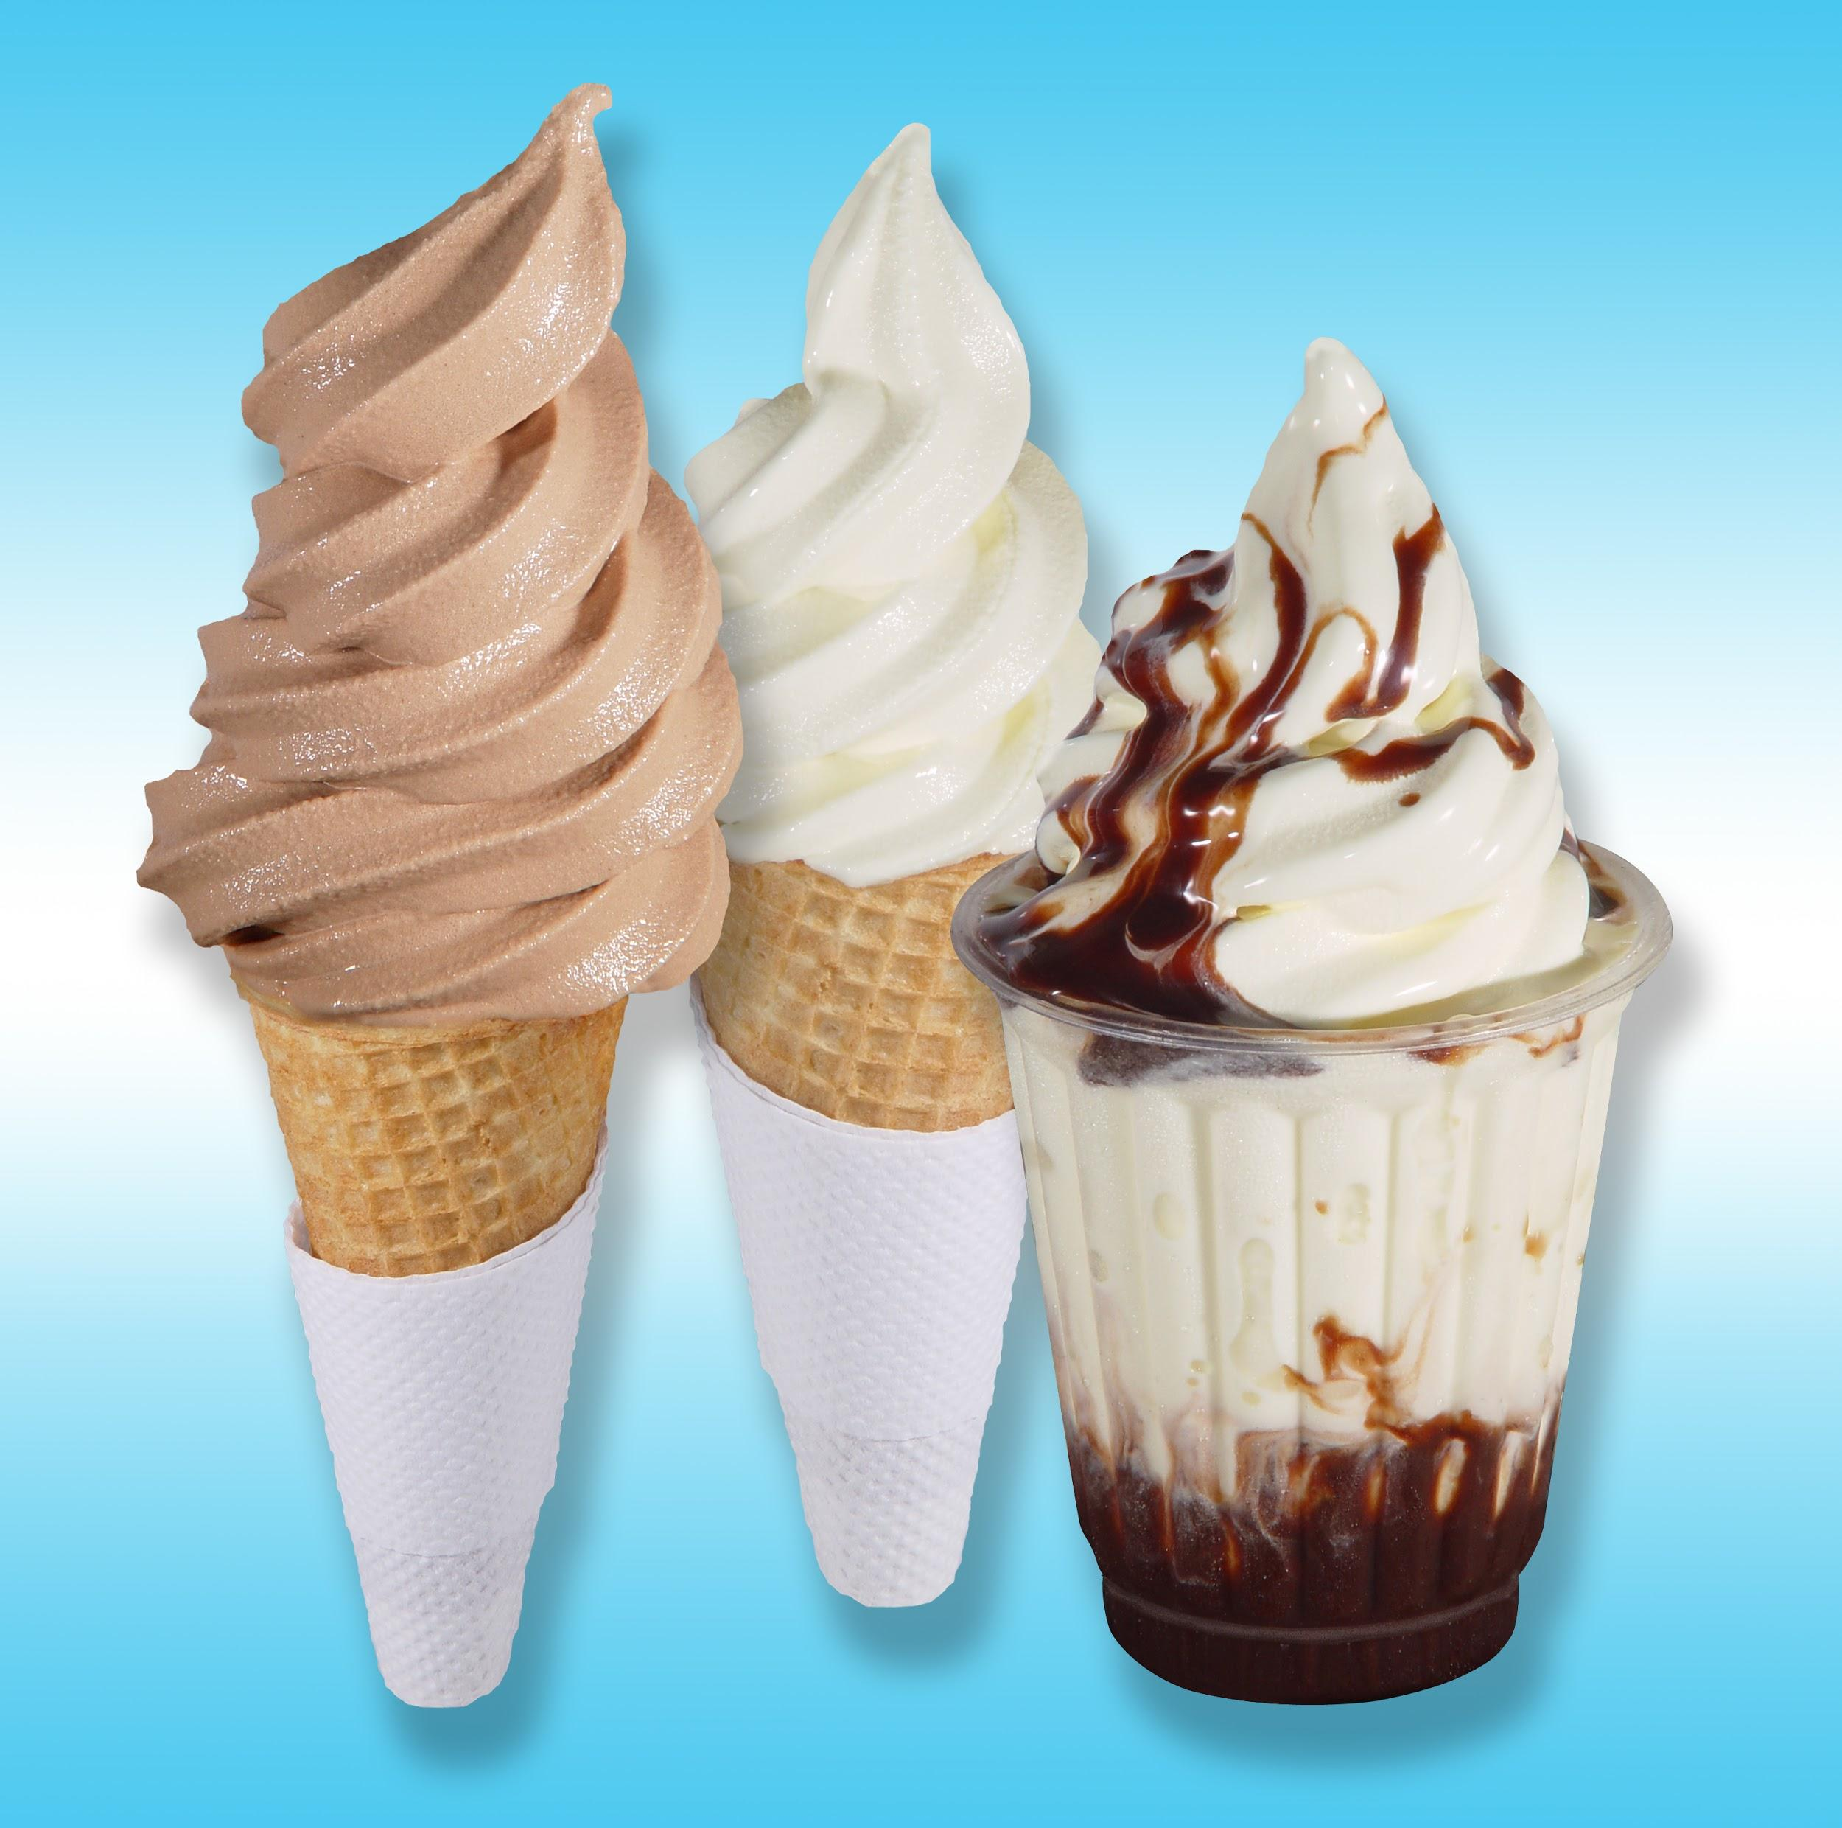
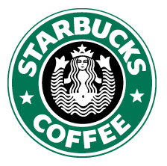
Pros
Starbucks Ice- Cream
Product Expansion
Appeal to a wider range of customers
Seasonal products to generate buzz
Utilize natural ingredients
Introduce coffee flavors
Premium priced
Alternative for a hot beverage
Healthier dairy based product

Slide 68
Cons
Starbucks Ice- Cream
Product Expansion
Additional staff training
Distribution channels
Customer approval/ likeness
Offered is select regions of the U.S.
Competing in a new industry
Maintenance and additional expenses
Initial marketing and product awareness

Slide 69
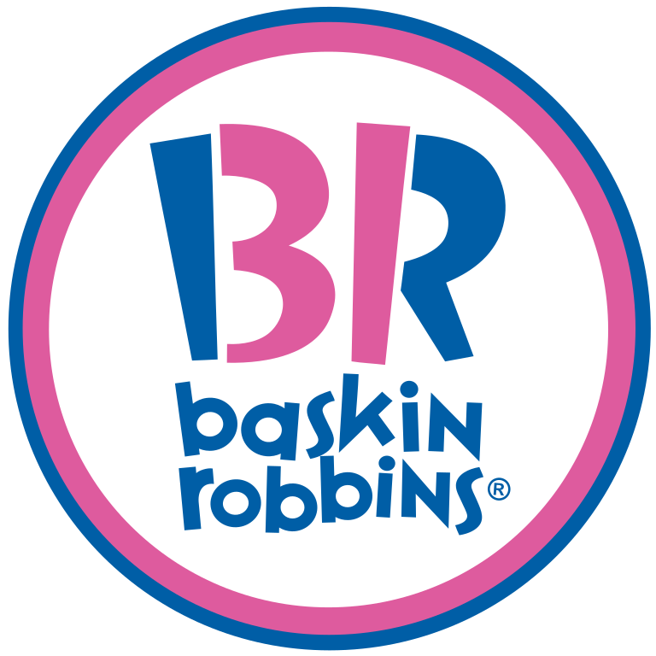
Pros
Acquisition of Baskin Robbins
Facilities are constructed
Product recognition is established
Baskin Robbins is in the declining stage
Purchase over 2K location at a discount rate
Facilities are equipped for new product ideas
Starbucks ice-cream to replace BR inside B&M grocery
Eliminate snack shops during winter seasons

Slide 70
Cons
Acquisition of Baskin Robbins
Overcrowding Starbucks current market
B&M location would be seasonal
Incorporating new equipment
Developing and training staff on new equipment
Risk losing customer loyalty
Entering as a new competitor in an unfamiliar market
Eliminating the unhealthy snacks myth

Slide 71

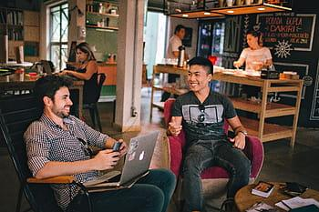
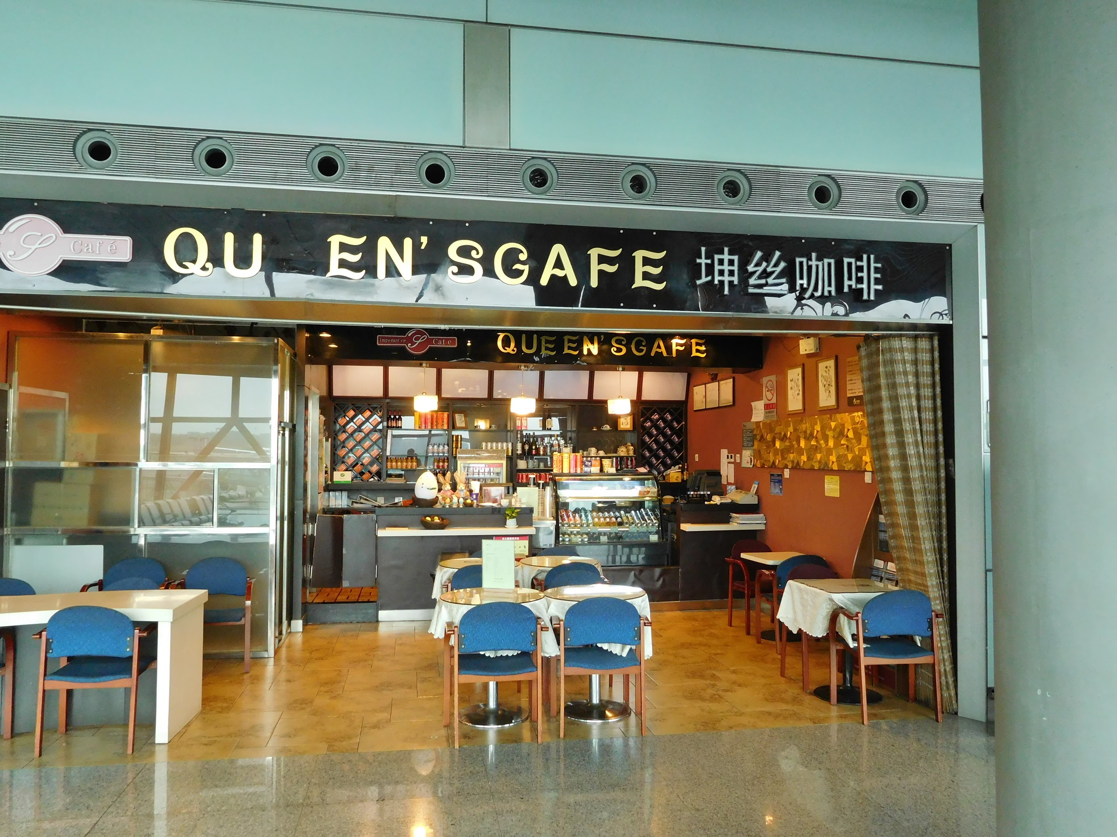
Pros
Merge with Lavazza Coffee
Well established reputation within our target market
Increase opportunities in CAP and EMEA
Experience an increase of market potential by 10 fold
Focus on natural ingredients/ Health focused alternatives

Slide 72
Cons
Merge with Lavazza Coffee
Accommodating a wide range of diverse cultures; executing necessary adjustments
Overcoming language barriers within the organization
Building effective relationship with global business partners and government
Managing a large area of operation; ensuring everyone in maximizing time and resources
Meeting all required government laws, tax rules, regulation, policies and procedures
Increased cost for all fines, damages, liabilities, and regulatory compliance
Discriminatory bias against an American brand for political objections

Slide 73

Financial Fit Best Choice
NPV IRR PI PP Prob. Prob*NPV Choice
New Product $59M 26% 1 3 65% 38.8M 2
Acquisition $-133M -6% 1 7 75% - 80M 3
Merger $3.24 B 14% 1 3.4 88% 285.2 M 1

Slide 74
Five Year Annual Financial Objective
 | Gross Revenue With Strategy Implementation | Current Gross Revenue Run Rate | Net Profit With Strategy Implementation | Current Run Rate Net Profit
2018 Actual |  | 25.2 B |  | 17.09 B
2019 Actual |  | 26.5 B |  | 17.98 B
2020 Projection | 29.4 B | 27.8 B | 20.24 B | 18.8 B
2021 Projection | 36.4 B | 29.1 B | 26.40 B | 19.70 B
2022 Projection | 43.7 B | 30.4 B | 33.65 B | 20.60 B
2023 Projection | 56.0 B | 31.7 B | 45.75 B | 21.50 B
2024 Projection | 69.0 B | 32.0 B | 58.25 B | 22.40 B

Slide 75
Implementation Plan
Consult with U.S., European, Middle Eastern, Asian and African finance advisors; expert advice for the merger
Conduct negotiation options with the leaders of Lavazza; solidify all new products and ingredients
Address the possible hurdles we may encounter with the merger such as regulatory guidelines, etc.
Finalize all financial and contractual procedures; licenses, insurance, etc.
Place all focus, financial and resources, into each region individually
Maximize all marketing resources, social media, poster and billboards, ads, and digital
Conduct a grand opening with sample serving, promotional giveaways, and half priced specials for a limited time
Complete the integration process; combined Starbucks with Lavazza
Continue to monitor and evaluate our performance as needed

Slide 76
Mission Statement
We are not in the coffee business to serve people;
We are in the people business to serve coffee

Slide 77
Plans and Triggers
If we fail to complete the merger with a global company If we do not achieve a 25% profit within the first 3 years If we encounter a significant restriction with laws, regulations and procedures If we do not accomplish our brand awareness goals If new products innovation exceed our our identified cost | Then Then Then Then Then | We will focus on a company within the United States We will delay the expansion into additional division globally We will implement upto 90 day recovery period until all regs are met We will invest a maximum of 15% additional funding cap We will attempt to reduce overhead cost/ expenses to remain within our budget/ Or limit the number of new products

Slide 78



Slide 79
References
https://www.investopedia.com/articles/markets/021316/how-starbucks-makes-money-sbux.asp
http://panmore.com/starbucks-coffee-company-organizational-structure
https://www.sec.gov/cgi-bin/browse-edgar?CIK=SBUX&Find=Search&owner=exclude&action=getcompany
https://www.lavazza.com/en/about-us/media-centre/financial-statements-2018.html
https://quotes.wsj.com/SBUX/financials
https://library.morningstar.com/v2/quote?id=0P00000546&typeid=ST
https://www.statista.com/statistics/1032200/coffee-shop-industry-market-size-us/
http://panmore.com/starbucks-coffee-five-forces-analysis-porters-model
https://smallbusiness.chron.com/key-success-factors-coffee-business-68398.html

Slide 80
References
https://www.investopedia.com/articles/markets/101415/top-6-companies-owned-starbucks.asp

